Slide 1
ECE 551 Digital Design And Synthesis
Fall ‘18
Behavioral Verilog
always & initial blocks
Coding flops
if else & case statements
Blocking vs Non-Blocking
Simulator Mechanics part duo

Slide 2
Administrative Matters
Readings
Cummings SNUG Paper (Verilog Styles that Kill) (posted on webpage)
Midterm: Weds Oct 24th, 7:15PM -- 9:00PM, in EH1800
Alternate Midterm is Tues Oct 23rd, 7:15PM in ??
Quiz Monday on Lecture04 materials
HW2 Due in 1 week.

Slide 3
Behavioral Verilog
Instead of describing what the hardware looks like, describe what you want the hardware to do
Goal: Abstract away the details of the hardware implementation to make design easier
The synthesizer creates a hardware structure that does the same thing as your description
… but the synthesizer has to be able to realize your description using real hardware constraints
This is why not all Verilog constructs are supported

Slide 4
Behavioral Verilog
initial and always form basis of all behavioral Verilog
All other behavioral statements occur within these
initial and always blocks cannot be nested
All <LHS> assignments must be to type reg (or logic if using SV)
initial statements start at time 0 and execute once
If there are multiple initial blocks they all start at time 0 and execute independently. They may finish independently.
If multiple behavioral statements are needed within the initial statement then the initial statement can be made compound with use of begin/end

Slide 5
More on initial statements
Initial statement very useful for testbenches
Initial statements don’t synthesize
Don’t use them in DUT Verilog (stuff you intend to synthesize)

Slide 6
initial Blocks
`timescale 1 ns / 100 fs
module full_adder_tb;
reg [3:0] stim;
wire s, c;
full_adder iDUT(sum, carry, stim[2], stim[1], stim[0]); // instantiate DUT
// monitor statement is special - only needs to be made once,
initial $monitor(“%t: s=%b c=%b stim=%b”, $time, s, c, stim[2:0]);
// tell our simulation when to stop
initial #50 $stop;
initial begin // stimulus generation
for (stim = 4’h0; stim < 4’h8; stim = stim + 1) begin
#5;
end
end
endmodule
all initial blocks start at time 0
multi-statement block enclosed by begin and end

Slide 7
Another initial Statement Example
module stim()
reg m,a,b,x,y;
initial
m = 1’b0;
initial begin
#5 a = 1’b1;
#25 b = 1’b0;
end
initial begin
#10 x = 1’b0;
#25 y = 1’b1;
end
initial
#50 $finish;
endmodule
Time
Event
0
m = 1’b0
5
a = 1’b1
Modelsim
10
x = 1’b0
30
b = 1’b0
35
y = 1’b1
50
$finish
What events at what times will a verilog simulator produce?

Slide 8
always statements
Behavioral block operates CONTINUOUSLY
Executes at time zero but loops continuously
Can use a trigger list to control operation; @(a, b, c)
In absense of a trigger list it will re-evaluate when the last <LHS> assignment completes.
module clock_gen (output reg clock);
initial
clock = 1’b0; // must initialize in initial block
always // no trigger list for this always
#10 clock = ~clock; // always will re-evaluate when
// last <LHS> assignment completes
endmodule

Slide 9
always vs initial
reg [7:0] v1, v2, v3, v4;
initial begin
v1 = 1;
#2 v2 = v1 + 1;
v3 = v2 + 1;
#2 v4 = v3 + 1;
v1 = v4 + 1;
#2 v2 = v1 + 1;
v3 = v2 + 1;
end
reg [7:0] v1, v2, v3, v4;
always begin
v1 = 1;
#2 v2 = v1 + 1;
v3 = v2 + 1;
#2 v4 = v3 + 1;
v1 = v4 + 1;
#2 v2 = v1 + 1;
v3 = v2 + 1;
end
What values does each block produce?
Lets take our best guess
Then lets try it in ModelSim

Slide 10
Trigger lists (Sensitivity lists)
Conditionally “execute” inside of always block
Any change on trigger (sensitivity) list, triggers block
always @(a, b, c) begin
…
end
Original way to specify trigger list always @ (X1 or X2 or X3)
In Verilog 2001 can use , instead of or always @ (X1, X2, X3)
Verilog 2001 also has * for combinational only always @ (*)
System Verilog introduced the always_comb

Slide 11
FlipFlops (finally getting somewhere)
A negedge is on the transitions
1 → x, z, 0
x, z → 0
A posedge is on the transitions
0 → x, z, 1
x, z → 1
Used for clocked (synchronous) logic (i.e. Flops!) always @ (posedge clk) register <= register_input;
Hey! What is this
assignment operator?

Slide 12
Implying Flops (my way or the highway)
reg q;
always @(posedge clk)
q <= d;
d
q
clk
It can be
A vector
too
reg [11:0] DAC_val;
always @(posedge clk)
DAC_val <= result[11:0];
Standard D-FF
with no reset
Be careful… Yes, a non–reset flop is smaller than a reset Flop, but most of the time you need to reset your flops.
Always error on the side of reseting the flop if you are at all uncertain.

Slide 13
Implying Flops (synchronous reset)
reg q;
always @(posedge clk)
if (!rst_n)
q <= 1’b0; //synch reset
else
q <= d;
d
q
rst_n
clk
Cell library might not contain a synch reset flop. Synthesis might combine 2 standard cells
How does this synthesize?
Many cell libraries don’t contain synchronous reset flops. This means the synthesizer will have to combine 2 (or more) standard cell to achieve the desired function… Hmmm? Is this efficient?

Slide 14
Implying Flops (asynch reset)
rst_n
reg q;
always @(posedge clk, negedge rst_n)
if (!rst_n)
q <= 1’b0;
else
q <= d;
R
d
q
clk
D-FF with asynch reset
Cell libraries will contain an asynch reset flop. It is usually only slightly larger than a flop with no reset. This is probably your best bet for most flops.
Reset has its affect asynchronous from clock. What if reset is deasserting at the same time as a + clock edge? Is this the cause of a potential meta-stability issue?

Slide 15
Know your cell library
What type of flops are available
+ or – edge triggered (most are positive)
Is the asynch reset active high or active low
Is a synchronous reset available?
Do I have scan flops available?
Code to what is available
You want synthesis to be able to pick the least number of cells to implement what you code.
If your library has active low asynch reset flops then don’t code active high reset flops.

Slide 16
What about conditionally enabled Flops?
reg q;
always @(posedge clk or negedge rst_n)
if (!rst_n)
q <= 1’b0; //asynch reset
else if (en)
q <= d; //conditionally enabled
else
q <= q; //keep old value
Dragons you will have to face though. The benefits of clock gating (particularly power benefits) are too great to ignore just because it is “hard to do”. In this class we “chicken out” and use recirculating flops style.
rst_n
How does this synthesize?
How about using a gated clock?
It would be lower power right?
Be careful, there be dragons here!
0
R
q
d
1
en
clk

Slide 17
Flop Inference in System Verilog
module simple_ff(input clk,d,rst_n,
output q);
reg q;
always @(posedge clk, negedge rst_n)
if (!rst_n)
q <= 1’b0;
else
q <= d;
endmodule
In standard verilog anything assigned inside an always block must be of type reg.
Standard verilog
module simple_ff(input clk,d,rst_n,
output q);
logic q;
always_ff @(posedge clk, negedge rst_n)
if (!rst_n)
q <= 1’b0;
else
q <= d;
endmodule
System Verilog contains a type called “logic” this can be used for signals that are assigned in always blocks or in structural or dataflow.
always_ff … no different, but
Synthesis tool will warn if didn’t
infer a flop.
System verilog

Slide 18
Behavioral: Combinational vs Sequential
Combinational
Not edge-triggered
All “inputs” (RHS nets/variables) are triggers
Does not depend on clock
Sequential
Edge-triggered by clock signal
Only clock (and possibly reset) appear in trigger list
Can include combinational logic that feeds a FF or register

Slide 19
Blocking vs non-Blocking
Blocking “Evaluated” sequentially
Works a lot like software (danger!)
Used for combinational logic
module addtree(output reg [9:0] out,
input [7:0] in1, in2, in3, in4);
reg [8:0] part1, part2;
always @(in1, in2, in3, in4) begin
part1 = in1 + in2;
part2 = in3 + in4;
out = part1 + part2;
end
endmodule
in1
in2
in3
in4
+
+
part1
part2
+
out

Slide 20
Non-Blocking Assignments
“Updated” simultaneously if no delays given
Used for sequential logic
module swap(output reg out0, out1, input rst, clk);
always @(posedge clk) begin
if (rst) begin
out0 <= 1’b0;
out1 <= 1’b1;
end
else begin
out0 <= out1;
out1 <= out0;
end
end
endmodule
D Q
rst to 0
out0
rst
clk
D Q
rst to 1
out1

Slide 21
Swapping if done in Blocking
Temp variable will be required
module swap(output reg out0, out1, input rst, clk);
reg temp;
always @(posedge clk) begin
if (rst) begin
out0 = 1’b0;
out1 = 1’b1;
end
else begin
temp = out0;
out0 = out1;
out1 = temp;
end
end
endmodule
D Q
rst to 0
out0
rst
clk
D Q
rst to 1
out1

Slide 22
More on Blocking
Called blocking because….
The evaluation of subsequent statements <RHS> are blocked, until the <LHS> assignment of the current statement is completed.
q1
q2
q3
module pipe(clk, d, q);
input clk,d;
output q;
reg q;
always @(posedge clk) begin
q1 = d;
q2 = q1;
q3 = q2;
end
endmodule
d
clk
Lets code this
Simulate this in your head…
Remember blocking behavior of: <LHS> assigned before
<RHS> of next evaluated.
Does this work as intended?

Slide 23
More on Non-Blocking
Lets try that again
q1
q2
q3
d
module pipe(clk, d, q);
input clk,d;
output q;
reg q;
always @(posedge clk) begin
q1 <= d;
q2 <= q1;
q3 <= q2;
end
endmodule;
clk
Lets code this
With non-blocking statements the <RHS> of subsequent statements are not blocked. They are all evaluated simultaneously.
The assignment to the <LHS> is then scheduled to occur.
This will work as intended.

Slide 24
So Blocking is no good and we should always use Non-Blocking??
Consider combinational logic
module ao4(z,a,b,c,d);
input a,b,c,d;
output z;
reg z,tmp1,tmp2;
always @(a,b,c,d) begin
tmp1 <= a & b;
tmp2 <= c & d;
z <= tmp1 | tmp2;
end
endmodule
The inputs (a,b,c,d) in the sensitivity list change, and the always block is evaluated.
New assignments are scheduled for tmp1 & tmp2 variables.
A new assignment is scheduled for z using the previous tmp1 & tmp2 values.
Does this work?

Slide 25
Why not non-Blocking for Combinational
Can we make this example work?
module ao4(z,a,b,c,d);
input a,b,c,d;
output z;
reg z,tmp1,tmp2;
always @(a,b,c,d) begin
tmp1 <= a & b;
tmp2 <= c & d;
z <= tmp1 | tmp2;
end
endmodule
module ao4(z,a,b,c,d);
input a,b,c,d;
output z;
reg z,tmp1,tmp2;
always @(a,b,c,d,tmp1,tmp2) begin
tmp1 <= a & b;
tmp2 <= c & d;
z <= tmp1 | tmp2;
end
endmodule
Yes
Put tmp1 & tmp2 in the trigger list
What is the downside of this?

Slide 26
Cummings SNUG Paper
Posted on ECE551 website
Well written easy to understand paper
Describes this stuff better than I can
Read it!
Outlines 8 guidelines for good Verilog coding
Learn them
Use them

Slide 27
Verilog Stratified Event Queue
Need to model both parallel and sequential logic
Need to make sure simulation matches hardware
Verilog defines how ordering of statements is interpreted by both simulator and synthesis tools
Simulation matches hardware if code well-written
Can have some differences with “bad” code
Simulator is sequential
Hardware is parallel
Race conditions can occur
“Making it work” in simulation does not mean it will work after synthesis

Slide 28
Why Need to Know Event Queue
In Behavioral Verilog, we describe the behavior of a circuit and the synthesizer creates hardware to try to match that behavior.
The “behavior” is the input/output and timing relationships we see when simulating our HDL.
Therefore, to understand the behavior we are describing, we must understand the order our statements will be executed in Simulation
Because the language is designed to express parallelism, the most challenging concept is figuring out the order that Verilog statements will occur in and how this will impact the behavior.

Slide 29
Determinism vs Non-Determinism
Standard guarantees some scheduling order
Statements in same begin-end block “executed” in the order in which they appear
Statements in different begin-end blocks in same simulation time have no order guarantee
module race(output reg f, input b, c);
always @(*) begin
f = b & c;
end
always @(*) begin
f = b | c;
end
endmodule
Race condition – which assignment to f will occur first vs. last in simulation is not known
Note that in hardware this actually models a SHORT CIRCUIT

Slide 30
Simulation Terminology [1]
These only apply to SIMULATION
Processes
Objects that can be evaluated
Includes primitives, modules, initial and always blocks, continuous assignments, tasks, and procedural assignments
Update event
Change in the value of a net or register (LHS assignment)
Evaluation event
Computing the RHS of a statement
Scheduling an event
Putting an event on the event queue

Slide 31
Simulation Terminology [2]
Simulation time
Time value used by simulator to model actual time.
Simulation cycle
Complete processing of all currently active events
Can be multiple simulation cycles per simulation time
Explicit zero delay (#0)
Forces process to be inactive event instead of active
Incorrectly used to avoid race conditions
#0 doesn’t synthesize!
Don’t use it

Slide 32
Verilog Stratified Event Queue [1]
Region 1: Active Events
Most events except those explicitly in other regions
Includes $display system tasks
Region 2: Inactive Events
Processed after all active events
#0 delay events (bad!)
Region 3: Non-blocking Assign Update Events
Evaluation previously performed
Update is after all active and inactive events complete
Region 4: Monitor Events
Caused by $monitor and $strobe system tasks
Region 5: Future Events
Occurs at some future simulation time
Includes future events of other regions
Other regions only contain events for CURRENT simulation time

Slide 33
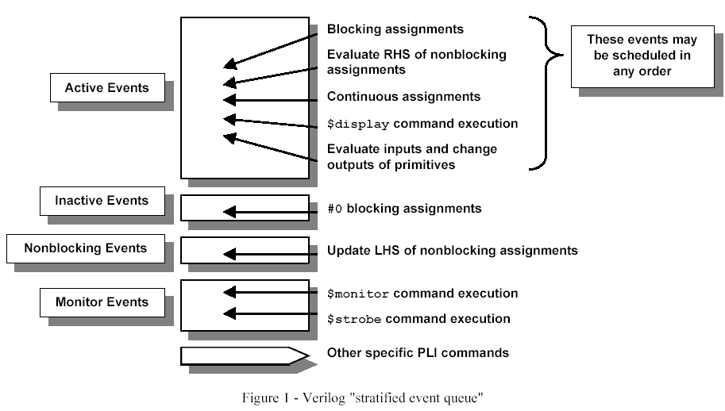
Verilog Stratified Event Queue [2]
within a block, blocking assignments,
are in order

Slide 34
Simulation Model
Let T be current simulation time
while (there are events) {
if (no active events) {
if (inactive events) activate inactive events
else if (n.b. update events) activate n.b. update events
else if (monitor events) activate monitor events
else { advance T to the next event time
activate all future events for time T }
}
E = pull event from event queue
if (E is an update event) {
update the modified object
add evaluation events for sensitive processes to the event queue
} else { // evaluation event (of non-blocking):
evaluate the process
add update event(s) to the event queue
}
}

Slide 35
Race Condition
assign p = q;
initial begin
q = 1;
#1 q = 0;
$display(p);
end
What is displayed?
What if $strobe(p) were used instead?

Slide 36
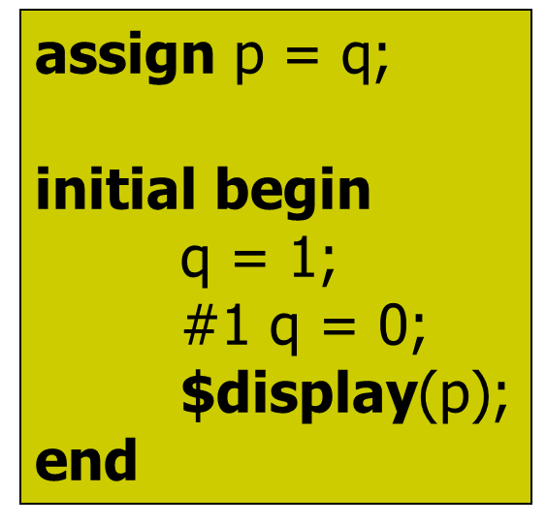
Hand Simulation of:
Active: | NB Update: | Future:
p=x
#1 q = 0,
q=1
$display(p)
p=1
q = 0,
$display(p)
p = 0
Time | Event/Action
0 p = x
0 q = 1
0 p = 1
1
q = 0
1 $display(1)
1 p = 0

Slide 37
Simulate This by Hand
always @(posedge clk, negedge rst_n)
if (!rst_n)
FF1 <= 1’b0
else
FF1 <= d;
always @(posedge clk)
FF2 <= FF1;
initial begin
clk = 0;
rst_n = 0;
d = 1;
#5 rst_n = 1;
#5 clk = 1;
end
Show queues vs time for:
Active events
Update events
Future events

Slide 38
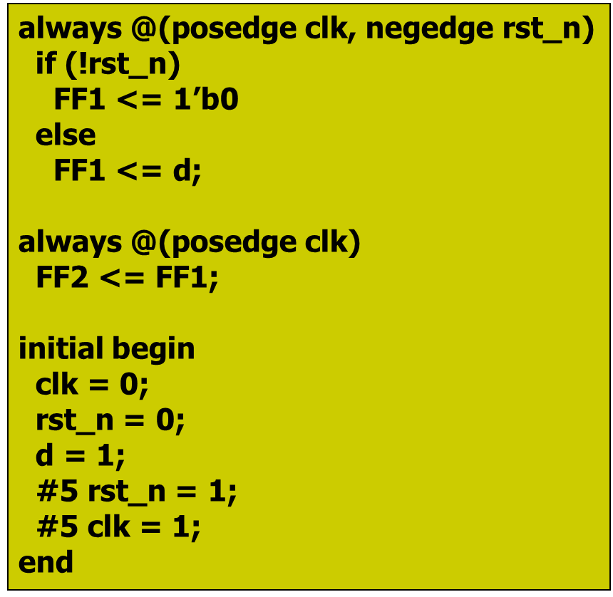
Hand Simulation of:
Active: | NB Update: | Future:
clk = 0 | FF1 <= 0 | #5 rst_n = 1
rst_n = 0 | FF1 <= 1 | #5 clk = 1
d= 1 | FF2 <= 0
always_FF1
FF1 = 0
rst_n = 1
clk = 1
always_FF1
always_FF2
FF1 = 1
FF2 = 0
Time | Event/Action
0 | clk = 0
0 | rst_n = 0
0 | d = 1
5 | rst_n = 1
10 | Clk = 1
10 | FF1 = 1
10 | FF2 = 0

Slide 39
What Do I Need to Know?
Don’t need to memorize
Exact Simulation model
The process of activating events from a region
Do need to understand
Order statements are evaluated
Active, Non-Blocking, and Monitor regions
$display vs. $strobe vs. $monitor
Separation of evaluation and update of non-blocking
Midterm will have a question related to event queue

Slide 40
if…else if…else statement
General forms…
if (condition)
begin
<statement1>;
<statement2>;
end
else
begin
<statement3>;
<statement4>;
end
if (condition)
begin
<statement1>;
<statement2>;
end
else if (condition2)
begin
<statement3>;
<statement4>;
end
else
begin
<statement5>;
<statement6>;
end
if (condition) begin
<statement1>;
<statement2>;
end
Of course the compound statements formed with begin/end are optional.
Multiple else if’s can be strung along indefinitely

Slide 41
How does and if…else if…else statement synthesize?
Does not conditionally “execute” block of “code”
Does not conditionally create hardware!
It makes a multiplexer or selecting logic
Generally:
Hardware for both paths is created
Both paths “compute” simultaneously
The result is selected depending on the condition
if (func_add)
alu = a + b;
else if (func_and)
alu = a & b;
else
alu = 8’h00;
+
alu
a[7:0]
1
&
0
8
1
b[7:0]
8’h00
0
8
func_and
func_add

Slide 42
if statement synthesis (continued)
if (a)
func = c & d;
else if (b)
func = c | d;
c
d
1
d
0
q
func
How does this
synthesize?
en
a
b
Latch??
What you ask for is what you get!
func is of type register. When neither a or b are asserted it didn’t not get a new value.
That means it must have remained the value it was before.
That implies memory…i.e. a latch!
Always have an
else to any if to avoid unintended
latches.

Slide 43
Latch Avoidance in System Verilog
reg func;
always @(a,b,c,d)
if (a)
func = c & d;
else if (b)
func = c | d;
logic func;
always_comb
if (a)
func = c & d;
else if (b)
func = c | d;
Traditional verilog
System verilog
Produces a latch, but gives no warning (unless hdlin_check_no_latch
is set true).
Produces a latch, but gives warning since always block said we intended combinational. No sensitivity list needed.
func has to be of type reg even though intent is not to infer a sequential element
func can be of type logic, which makes more sense than reg

Slide 44
More on if statements…
Watch the sensitivity lists…what is missing in this example?
always @(a, b) begin
temp = a – b;
if ((temp < 8’b0) && abs)
out = -temp;
else out = temp;
end
always @ (posedge clk) begin
if (reset) q <= 0;
else if (set) q <= 1;
else q <= data;
end
What is being coded here?
Is it synchrounous or asynch?
Does the reset or the set have
higher priority?

Slide 45
Example: Comparator
module compare_4bit_behave(output reg A_lt_B, A_gt_B, A_eq_B,
input [3:0] A, B);
always@( ) begin
end
endmodule
A,B
//// default outputs to prevent latches ////
A_lt_B = 0;
A_gt_B = 0;
A_eq_B = 0;
if (A==B)
A_eq_B = 1;
else if (A<B)
A_lt_B = 1;
else
A_gt_B = 1;
Flush out this template with sensitivity list and implementation
Hint: a if…else if…else statement works well for implementation

Slide 46
Example: Comparator
module compare_4bit_behave(output reg A_lt_B, A_gt_B, A_eq_B,
input [3:0] A, B);
always@( ) begin
end
endmodule
A,B
if (A==B) begin
A_lt_B = 0;
A_eq_B = 1;
A_gt_B = 0;
end else if (A<B) begin
A_lt_B = 1;
A_eq_B = 0;
A_gt_B = 0;
end else begin
A_lt_B = 0;
A_eq_B = 0;
A_gt_B = 1;
end
46

Slide 47
case Statements
Verilog has three types of case statements:
case, casex, and casez
Performs bitwise match of expression and case item
Both must have same bitwidth to match!
case
Can detect x and z! (good for testbenches)
casez
Uses z and ? as “don’t care” bits in case items and expression
casex
Uses x, z, and ? as “don’t care” bits in case items and expression

Slide 48
Case statement (general form)
case (expression)
alternative1 : statement1; // any of these statements could
alternative2 : statement2; // be a compound statement using
alternative3 : statement3; // begin/end
default : statement4 // always use default for synth stuff
endcase
localparam AND = 2’b00;
localparam OR = 2’b01;
localparam XOR = 2’b10;
case (alu_op)
AND : alu = src1 & src2;
OR : alu = src1 | src2;
XOR : alu = src1 ^ src2;
default : alu = src1 + src2;
endcase
Why always have a default?
Same reason as always having an else with an if statement.
All cases are specified, therefore no unintended latches.

Slide 49
Using case To Detect x And z
Only use this functionality in a testbench!
Example taken from Verilog-2001 standard:
case (sig) 1’bz: $display(“Signal is floating.”); 1’bx: $display(“Signal is unknown.”); default: $display(“Signal is %b.”, sig);
endcase

Slide 50
casex Statement
Uses x, z, and ? as single-bit wildcards in case item and expression
Uses first match encountered
always @ (code) begin casex (code) // case expression
2’b0?: control = 8’b00100110; // case item1 2’b10: control = 8’b11000010; // case item 2 2’b11: control = 8’b00111101; // case item 3 endcase
end
What is the output for code = 2’b01
What is the output for code = 2’b1x

Slide 51
casez Statement
Uses z, and ? as single-bit wildcards in case item and expression
always @ (code) begin casez (code)
2’b0?: control = 8’b00100110; // item 1
2’bz1: control = 8’b11000010; // item 2 default: control = 8b’xxxxxxxx; // item 3
endcase
end
What is the output for code = 2b’01
What is the output for code = 2b’zz

Slide 52
How Does a case(x) Statement Synthesize?
Remember the First Match is taken
(there is an inferred priority)
a
b
c
out
always @(sel,a,b,c)
case (sel)
2’b00 : out = a;
2’b01 : out = b;
default : out = c;
endcase;
c
2
Synthesis Tool
or this?
a
1
c
1
0
Depends on several factor including
some synthesis directives. However the 2nd case is what we expect it to do without any directives. System verilog gives us more control.
0
b
sel[1]
sel[1:0]

Slide 53
System Verilog Case Options
always @(sel,a,b,c)
unique case (sel)
2’b00 : out = a;
2’b01 : out = b;
default : out = c;
endcase;
a
b
Synthesis Tool
out
c
c
2
always @(sel,a,b,c)
priority case (sel)
2’b00 : out = a;
2’b01 : out = b;
default : out = c;
endcase;
a
1
c
1
Synthesis Tool
0
b
0
sel[1]
sel[1:0]

